Slide 1

Technical Methodology & Insights
Exploratory Data Analysis using Tableau
Names:- Shubham Dhar , Smita R Nidavani , Sushant Salunke

Slide 2
Agenda
Objective
Data Source
Data Model in Tableau
Data Cleaning
Variable Classifications
Key Insights
Parameter Creation & Filtering
Dashboard & Interaction
Conclusion

Slide 3
Objective
To understand following using historical Namma Yatri data
Ride patterns
Demand trends
Revenue hotspots
Operational bottlenecks

Slide 4
Data Source
Trips
Trip Details
Assembly
Payment
Duration

Slide 5
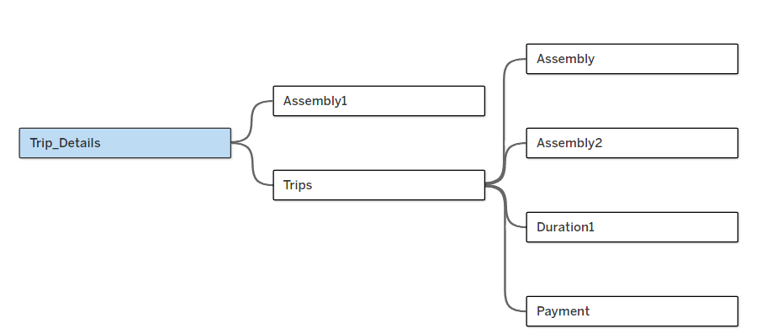
Data Model in Tableau
.Established relationship between tables using Trip_id, loc_from, faremethod, duration_id etc.
Used appropriate conditions like many-to-one, one-to-one.

Slide 6
Data Cleaning
Created Calculated Fields
Cancelled Trips – if either Driver or Customer cancelled Trip
Same Location Trips - to flag loc_from = loc_to with unrealistic fare
Changed datatypes (e.g., numeric to string to avoid aggregation errors)

Slide 7
Variable Classification
Table Name | Column Name | Categorical / Numerical
Assembly | Assembly_ID | Categorical
 | Assembly | Categorical
Duration | duration_id | Categorical
 | duration | Categorical
Payment | id | Categorical
 | method | Categorical
Trip Details | tripid | Categorical
 | loc_from | Categorical
 | searches | Categorical
 | searches_got_estimate | Categorical
 | searches_for_quotes | Categorical
 | searches_got_quotes | Categorical
 | customer_not_cancelled | Categorical
 | driver_not_cancelled | Categorical
 | otp_entered | Categorical
 | end_ride | Categorical
Trips | tripid | Categorical
 | faremethod | Categorical
 | fare | Numerical
 | loc_from | Categorical
 | loc_to | Categorical
 | driverid | Categorical
 | custid | Categorical
 | distance | Numerical
 | duration | Categorical
We classified Variables to ensures correct use of filters, aggregations and colour legends in Tableau

Slide 8
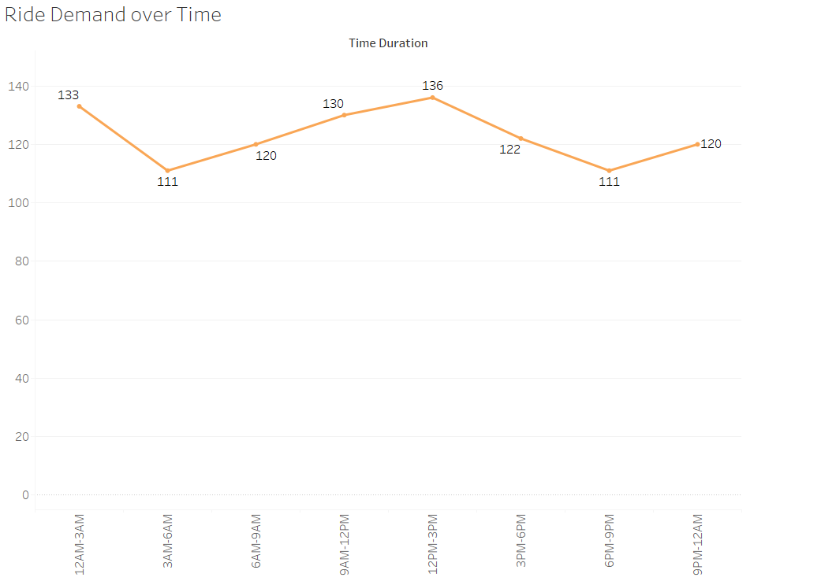
Key Insights I – Actual peak Hours not Peaky
Peak hours are obtained during mid – night & Mid – day.
Demand is steady with dips early morning; opportunity to boost rides during mildly busy hours (12–3 PM).

Slide 9
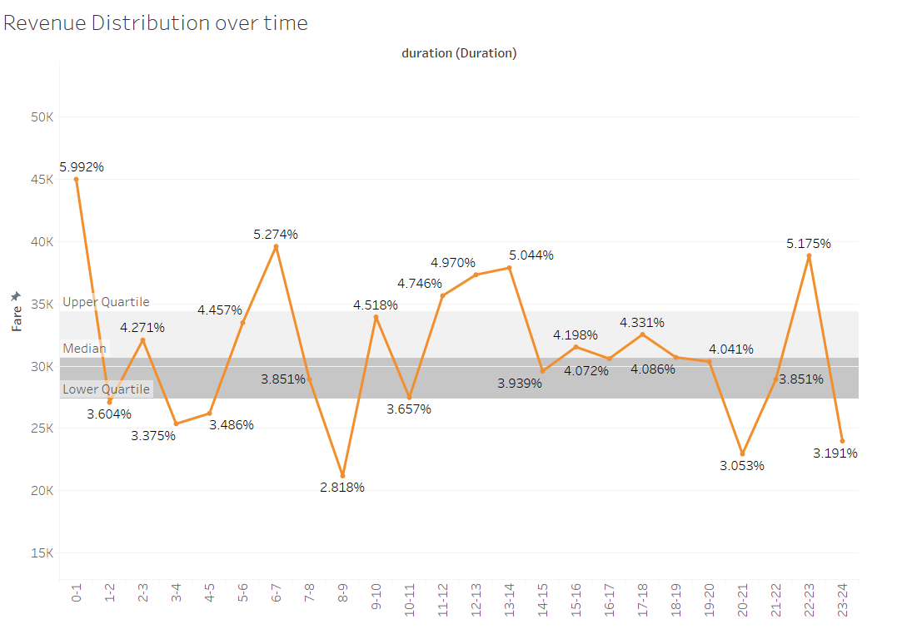
Key Insights II – Lowest Revenue During Peak hour
During 8-9AM lowest 2.88% Revenue of overall.
During 12PM-1AM highest 5.99% Revenue of overall.
Decision point: Explore pricing strategies or targeted driver coverage during these hours.

Slide 10
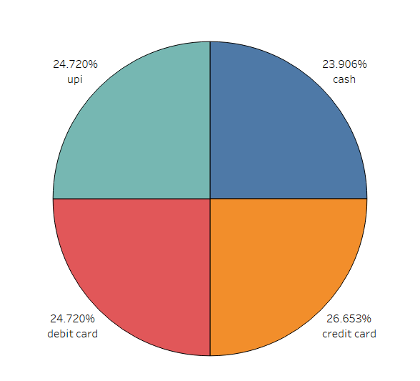
Key Insights III – Promote UPI for cost Saving
Credit Card (26.65%) is dominant
Suggestion: Ensure seamless experience for top methods; promote UPI for cost-saving

Slide 11
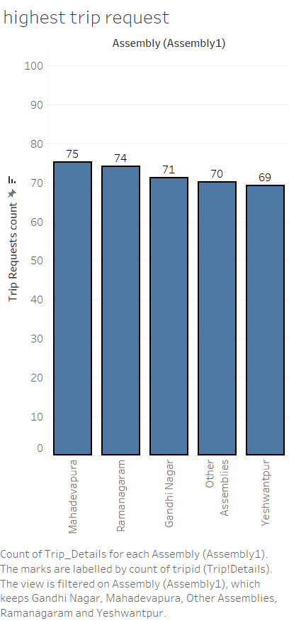
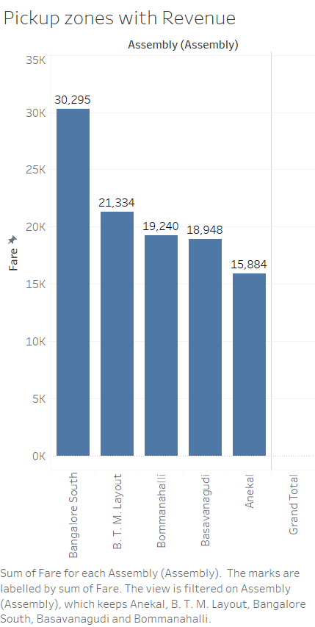
Key Insights IV – High Performing Zones
Top Zone by Trip value – Mahadevapura
Top Zone by Revenue – Bangalore South
Suggestion: Prioritize driver distribution and targeted promotions in these areas

Slide 12
Key Insights V – 47-48% Cancellation
Nearly 47–48% cancellation → Operational gap → lost revenue
Recommendation : Focused driver training or incentives to reduce cancellation + customer assurance initiatives
 | For Drivers | For Customer
Successful Rides | 52.75% | 51.83%
Cancelled Rides | 47.25% | 48.17%

Slide 13
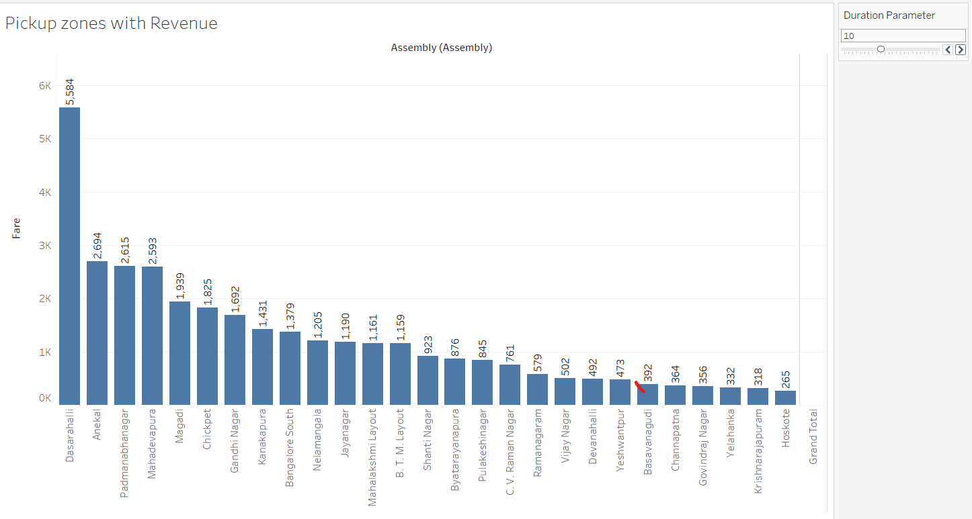
Parameter Creation & Filtering
Created Duration Parameter & Duration as Filter.
We used this to create Interactive filter to view hourly revenue by location
Insight: e.g., Dasarahalli shows highest revenue at 9–10AM

Slide 14
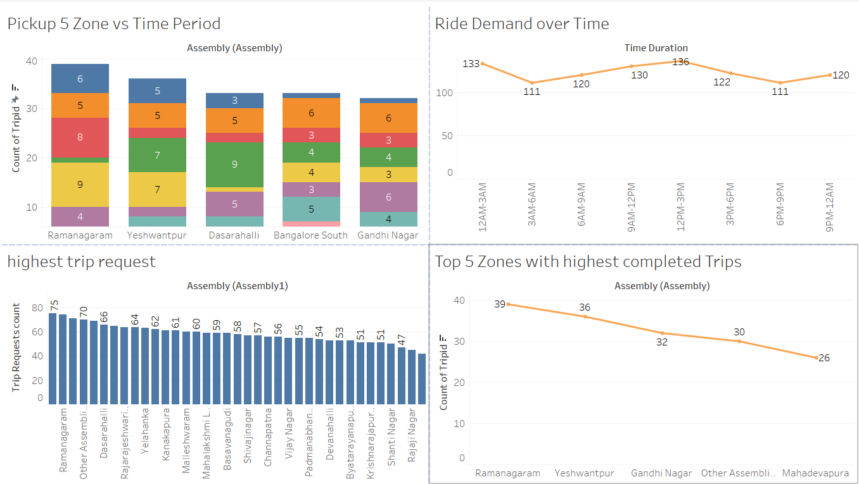
Dashboards & Interactions
Created by using Charts and through this we can interact and do the filter operation for all the graphs.
Data team can use this for internal monitoring .

Slide 15
Conclusion
This methodology ensures a clean, actionable, and scalable foundation for ongoing ride analytics

Slide 16
Thank You

